Slide 1
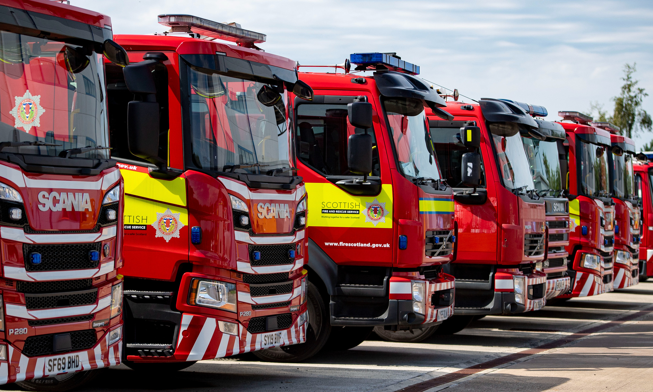

SCOTTISH FIRE AND RESCUE SERVICE
SERVICE DELIVERY REVIEW
Glossary

Slide 2
Term | Explanation
Pump (Pumping Appliance) | Fire engine with fire and rescue capability, crewed by a minimum of 4 firefighters.
Appliance | Generic term for any operational fire and rescue vehicle e.g. a pump or a specialist vehicle such as an aerial ladder platform.
1st and 2nd Pumps | Many urban fire stations have two fire engines (pumping appliances). These are referred to as the station’s 1st pump and 2nd pump. At some incident types, the arrival of 2 pumps is required to provide sufficient firefighters to implement fully effective working practices.
Duty System | The working arrangements and shift patterns of firefighters which ensure that fire appliances are appropriately crewed.
Five Watch Duty System (5WDS) | Wholetime (or full-time) firefighters grouped into five watches. The system enables rapid 24-hour incident response times. It is typically used in urban areas, where the highest incident risk and demand occurs.
TOM | Target Operating Model. The agreed minimum number of wholetime firefighters required at each fire station to adequately crew the fire appliances.
OC | On Call Duty System. Part-time firefighters, who usually have another job, and respond to their station for incidents via a paging system.
DSDS | Day Shift Duty System. Whole-time firefighters provide rapid incident response and supporting activities from 8am to 6pm, Monday to Friday. Out-with these hours, the pump is crewed by On-Call firefighters.

Slide 3
Term | Explanation
SDA | Service Delivery Area. SFRS splits Scotland into three SDAs: North, East and West. Each of these areas broadly covers a third of the population of Scotland.
LSO | Local Senior Officer. SFRS has fourteen LSOs who have overall responsibility for Service delivery in one, or more, local authority areas. LSO Areas include “Glasgow City”, “Falkirk and West Lothian”, and “Perth & Kinross, Angus and Dundee City”.
PP&P | Prevention, Protection and Preparedness. The part of our work which aims to prevent incidents from happening in the first place, reduces the impacts of incidents on communities when they do occur, and pre-plans our incident responses.
MORRD | Matching Operational Resources to Risk and Demand. Ensuring we have the right resources (fire engines and specialist equipment) in the right place and that they are suitably crewed at the right time. This is based on community risk and response times.
Datazone | Broadly similar to the concept of postcodes, Scotland is split into c.7000 datazones. Each has roughly the same size of population and similar community characteristics. We collate data relating to these small areas to help us analyse types and levels of community risk.
CRIM | Community Risk Index Model. A statistical tool which scores the fire and rescue incident risk within each datazone. This uses historical incidents, community characteristics, types of building, other infrastructure (e.g. roads) and natural features (e.g. water) to help us identify where risks occur in communities. This helps us to target our prevention activities and arrange the distribution of our fire stations and appliances.

Slide 4
Term | Explanation
SURC | The Scottish Government Urban Rural Classification provides a consistent way of defining different types of urban areas, large towns and rural areas across Scotland. It is based on population density and accessibility to community services. SFRS uses this information to help compare its incident response times.
Benchmark Response Times | These are the average historic fire engine response times achieved in each type of SURC area. Benchmarking creates a common reference point for comparing response times in similar types of area. It is NOT used as a response time target.
RAAC | Reinforced Autoclave Aerated Concrete. Some properties built in the 1950s-90s were constructed using RAAC panels. Over time RAAC panels are susceptible to degrading and becoming structurally unsafe. Some of our RAAC fire station buildings have required temporary structural support. Replacing, or upgrading, our RAAC stations is an organisational priority.
Option | A proposed possible change in how we provide our service in a particular area.
Configuration | Some options have knock-on effects on other stations. These have been grouped together - either geographically or by theme.
Long-Term Dormant Stations (LTDS) | Fire stations in remote rural areas which have been non-operational for a significant period due to an inability to maintain sufficient OC firefighters.

Slide 5
Term | Explanation
Nucleus Crew | A crew of employees with the operational skills and knowledge required to support a geographical cluster of On-Call stations. They can be deployed dynamically to one or more On-Call station locations to support On-Call pump availability and deliver local prevention and preparedness activities.
VDS | Volunteer Duty System – operates on a similar basis to the On-Call duty system, but with less mandatory contractual commitments/capabilities. Most common in remote rural areas of the country.
Re-training | When an employee is given additional training to equip them with new skills, in order to prepare them for a new role.
Re-deployment | When an employee can no longer work in their existing specific job and attempts are made to find them an alternative post.
Relocation | When an employee moves from an existing work base to another.

