Slide 1
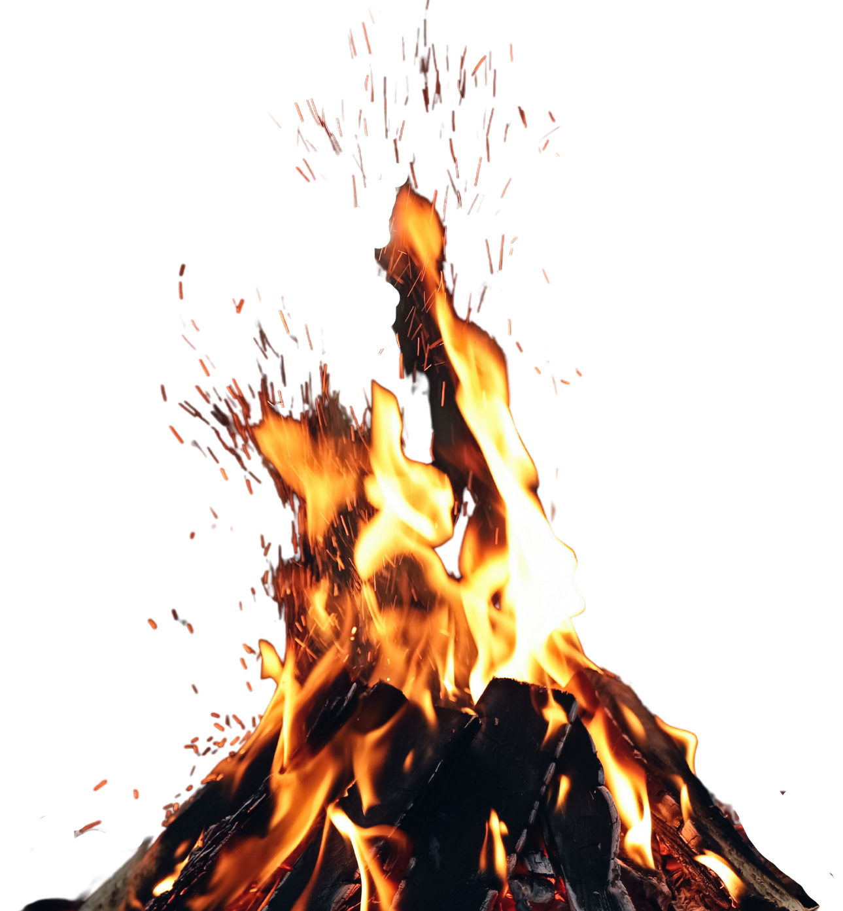
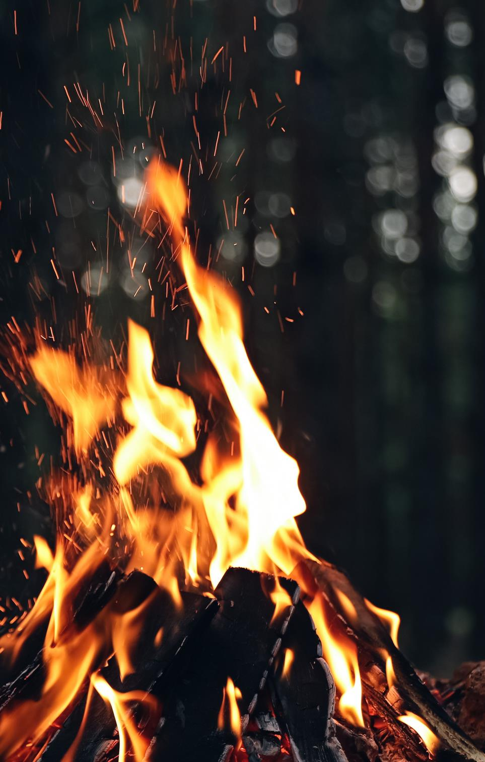


FIREWORK & BONFIRE SAFETY
PRIMARY
SCHOOL LEVEL
2023 - 2024
Notes:
Introduce yourselves to the young people and tell them a little bit about what you do and why you are here today.​

Slide 2
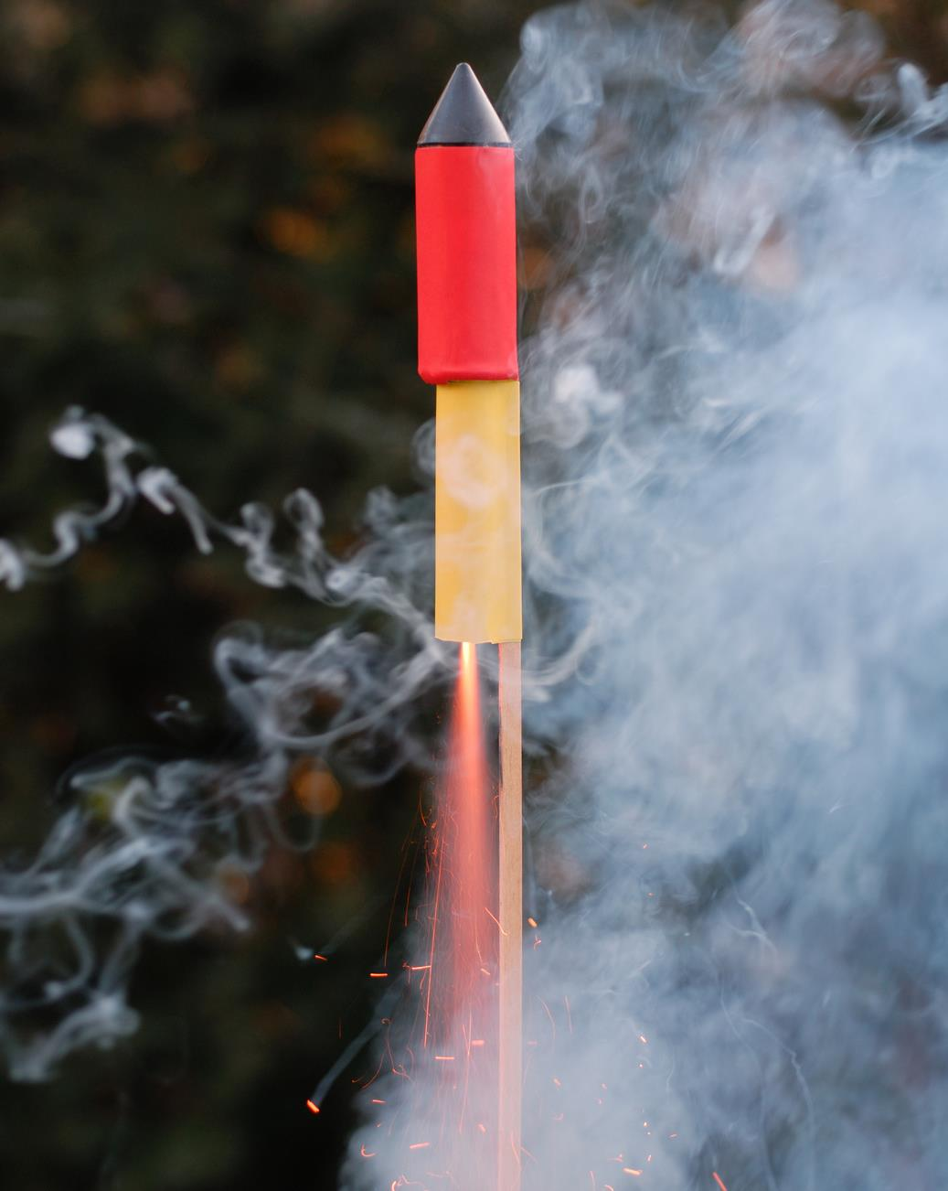


HAVE YOU BEEN TO A
FIREWORKS DISPLAY?
Fireworks can be fun …
but they can also be dangerous.
A firework is
essentially a missile designed to explode in a very controlled way with bangs and bursts of brightly coloured light. ​
IT IS SAFER TO GO WITH AN ADULT TO AN ORGANISED DISPLAY
Notes:
ASK
Why do fireworks come in different shapes and sizes and are attractive to look at?
ANSWER:
This is a marketing technique as it makes them look exciting and fun. It is one of the ways that the firework manufacturers can sell these fireworks to the parents or guardians of the pupils and the public

Slide 3
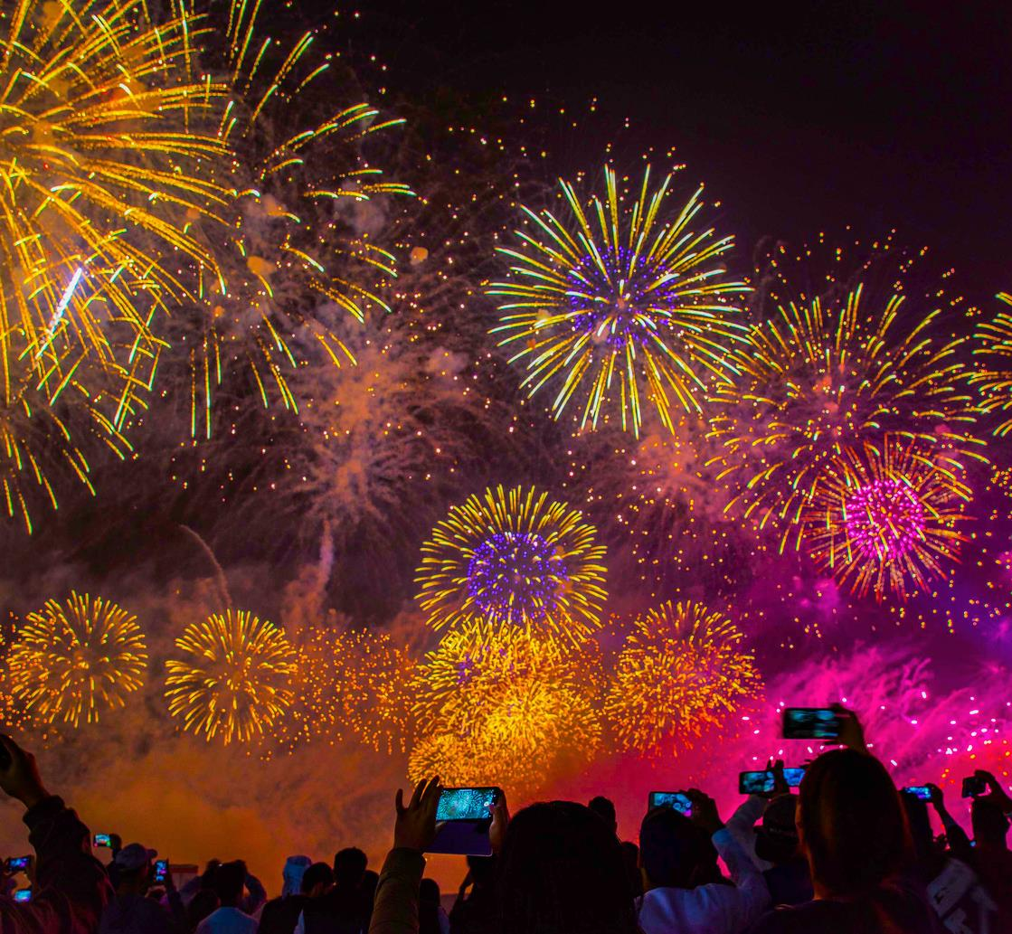

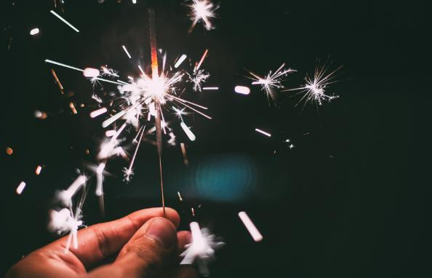
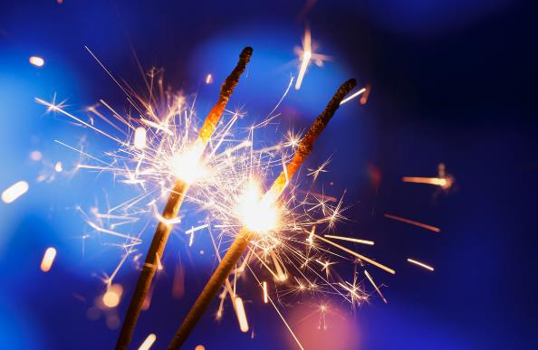
FIREWORKS
FACT
DID YOU KNOW
that sparklers can burn five times hotter than a BBQ?
DO YOU KNOW THERE IS A FIREWORKS CODE?

Slide 4

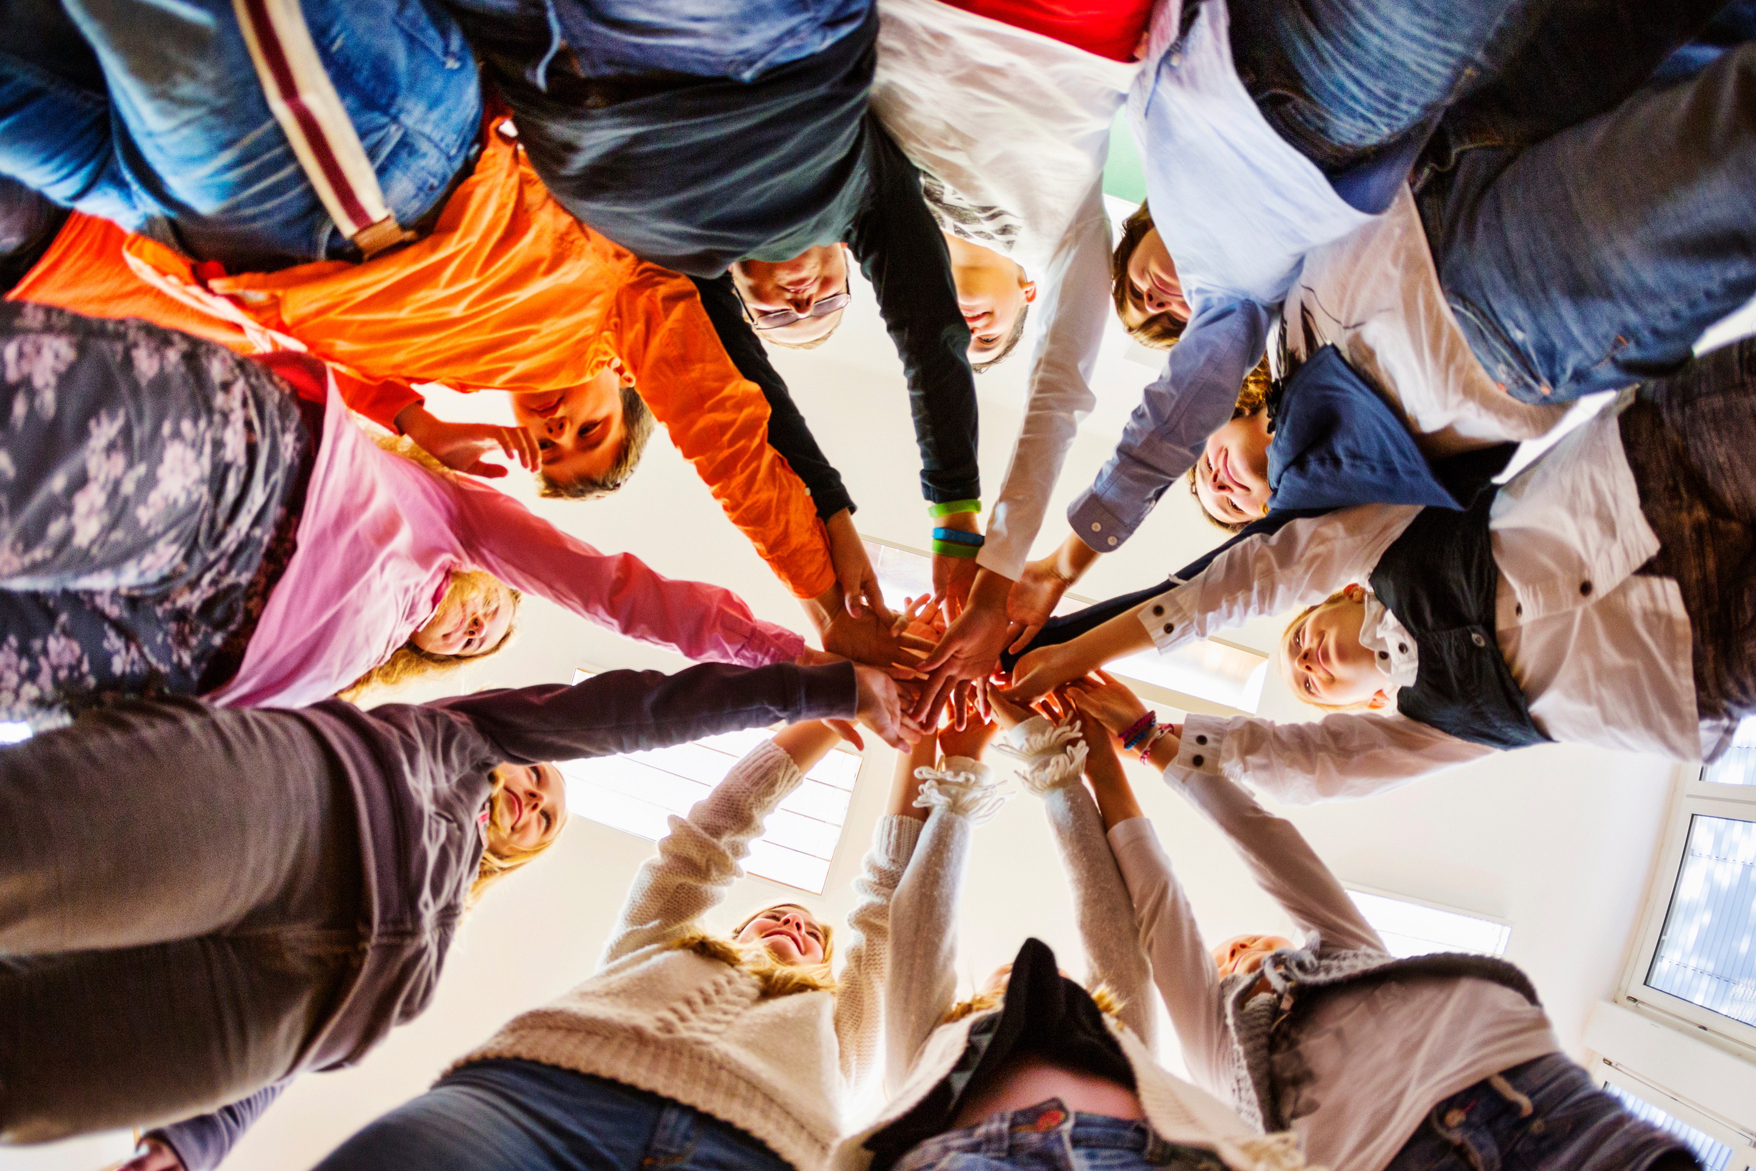

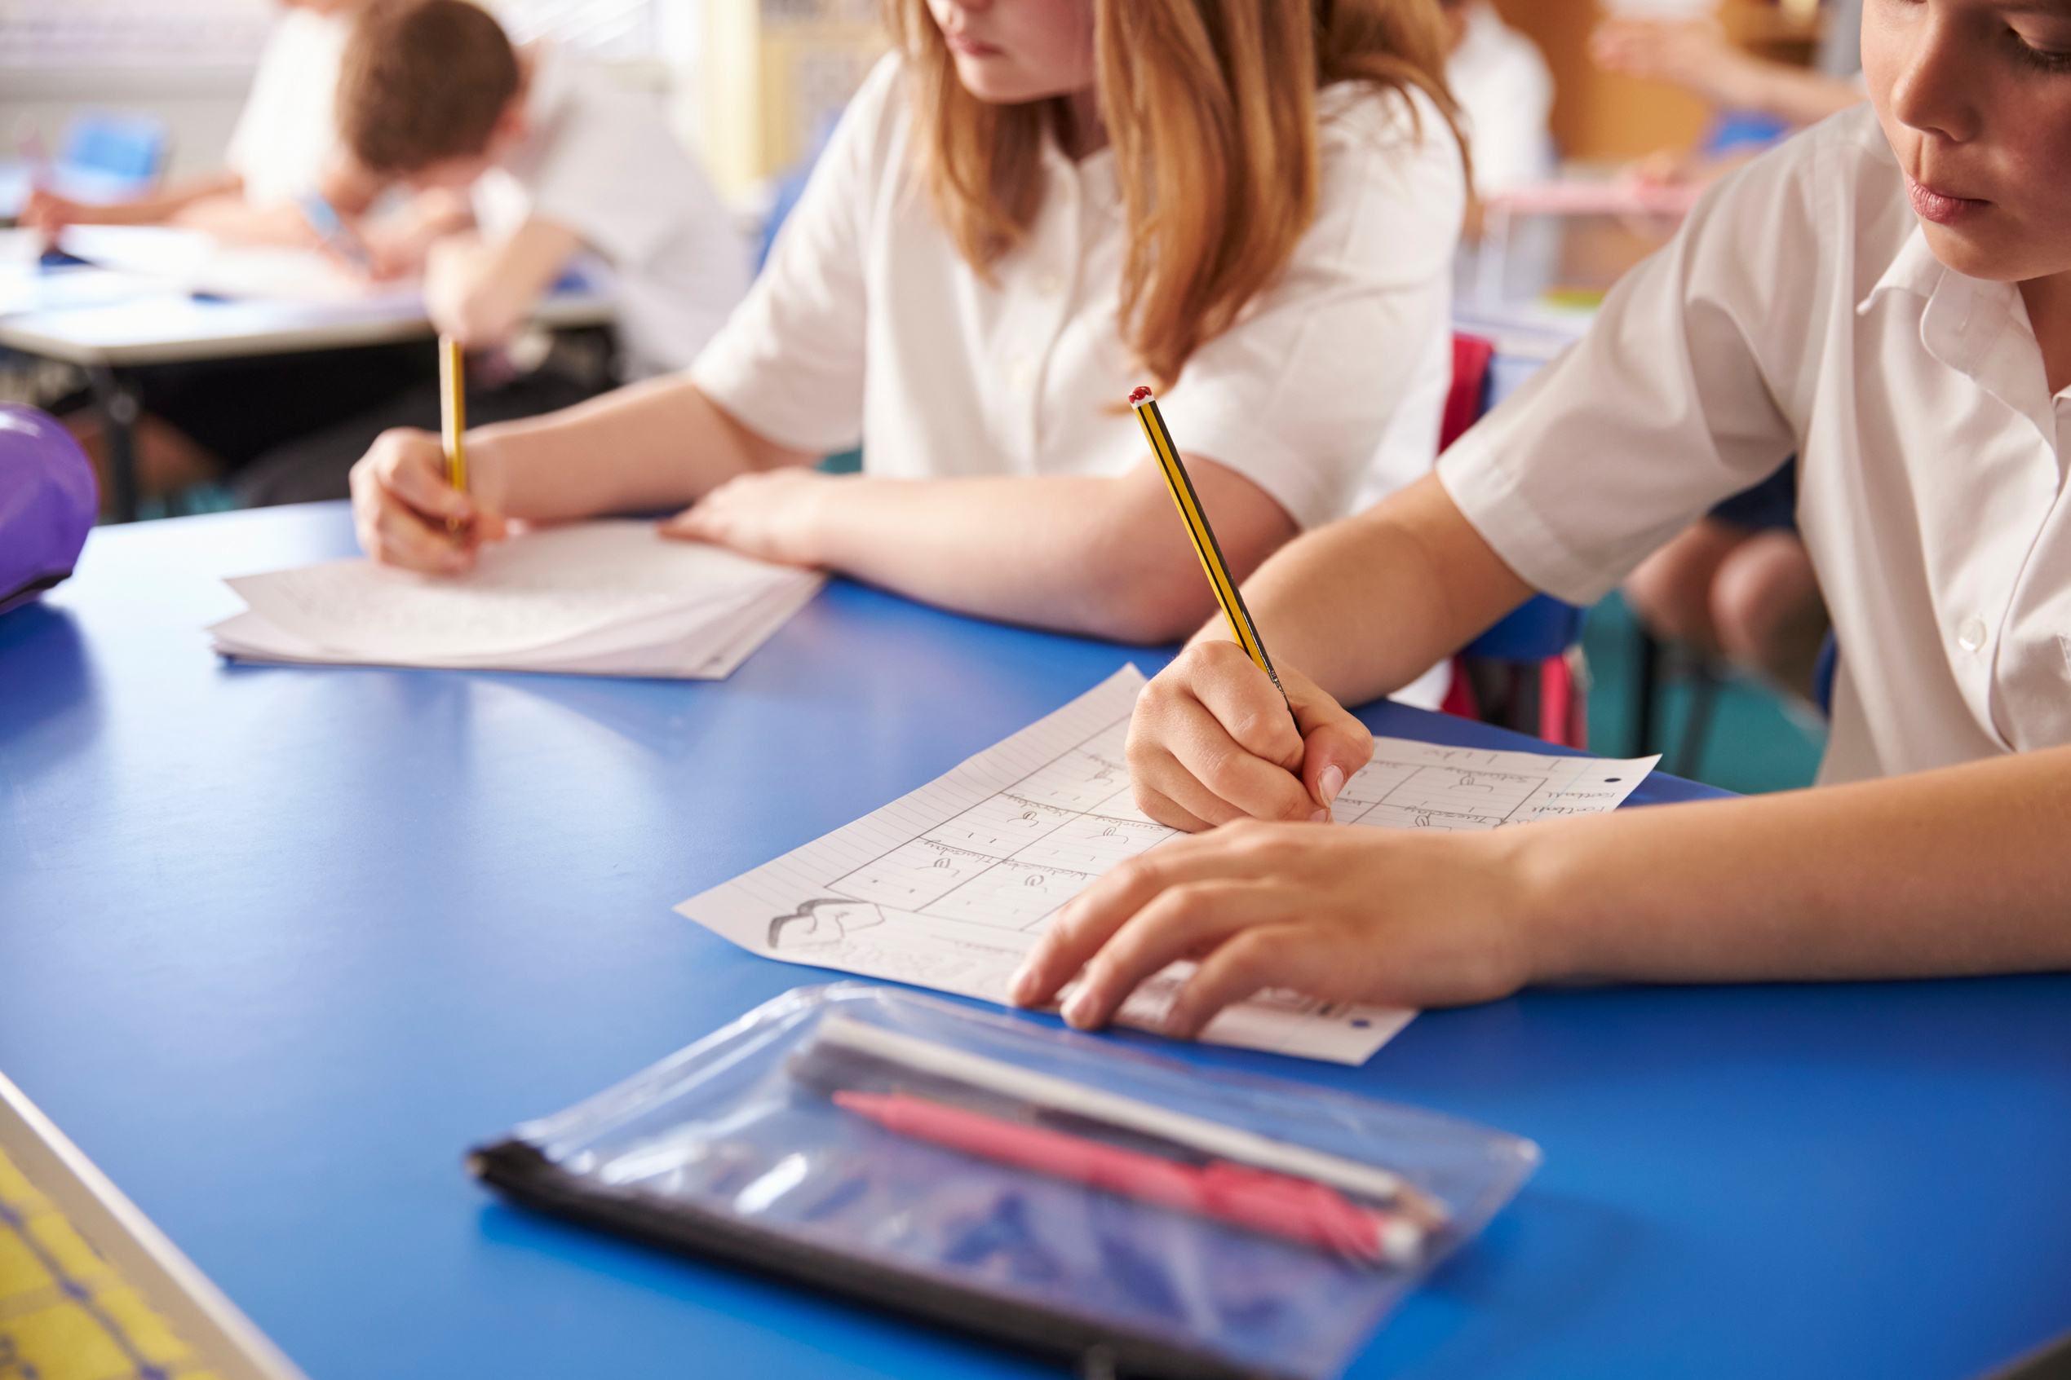
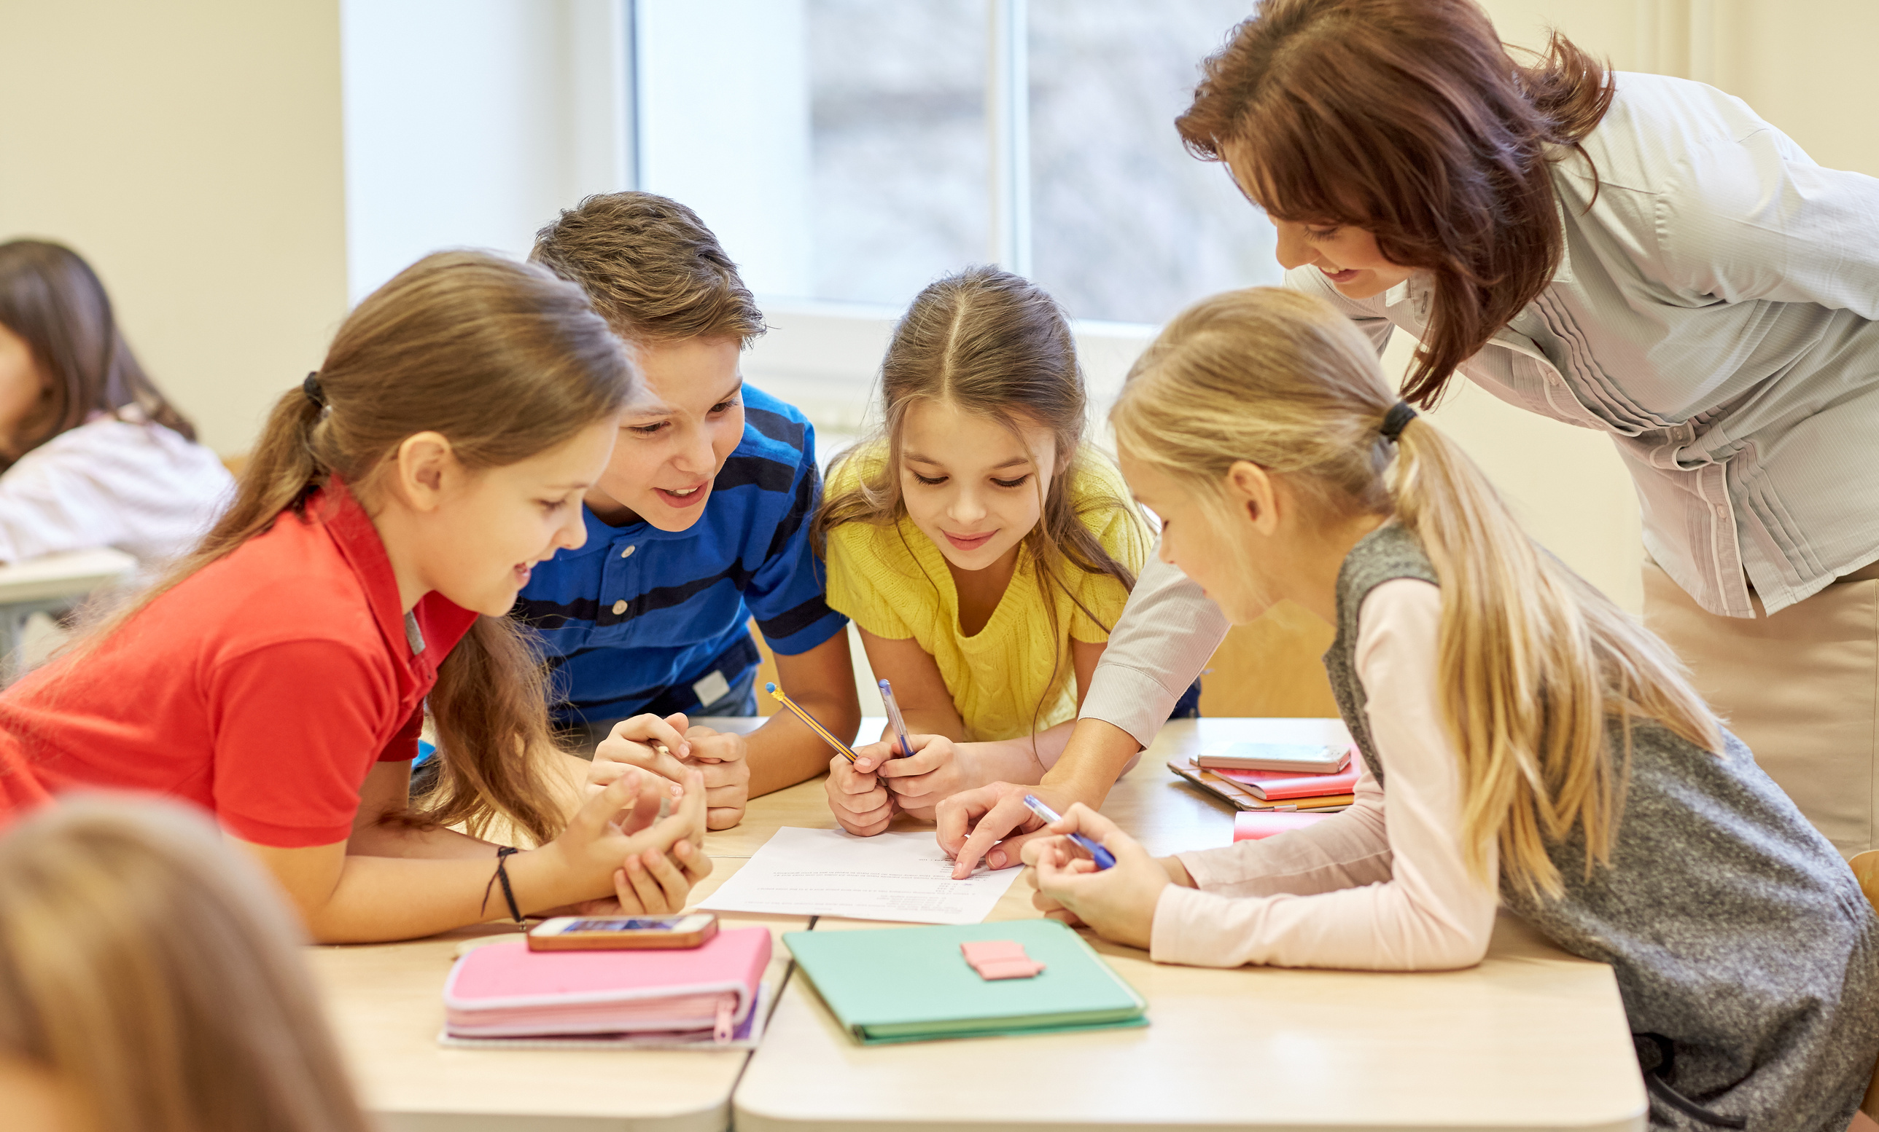
ACTIVITY​
IN YOUR GROUPS TELL US WHAT YOU THINK IS IN
THE FIREWORKS SAFETY CODE?​
Notes:
Have the young people split into small groups and have them note down what they think is in the code – Give no more than 5 minutes for this and then have them feedback 2 of the things they have. ​
The purpose of this exercise is to determine what the young people already know about the firework code and when going through the code on the next 2 slides what you need to spend more time on eg they don’t know about paraffin.​
Most should have an understanding that only adults should light them, they should stand well back and never go back to an lit firework that has not gone off, or to throw fireworks in any way.​
ASK
Why should Fireworks not be kept in your pocket?
ANSWER
The friction could cause the firework to go off, causing serious injury and permanent damage.
Other topics to discuss:
Never return to a firework once it has been lit- even if it hasn't gone off it could still explode.
Direct any rocket fireworks well away from spectators
Never use paraffin or petrol on a bonfire
Make sure that the fire is out and surroundings are made safe before leaving.
​

Slide 5
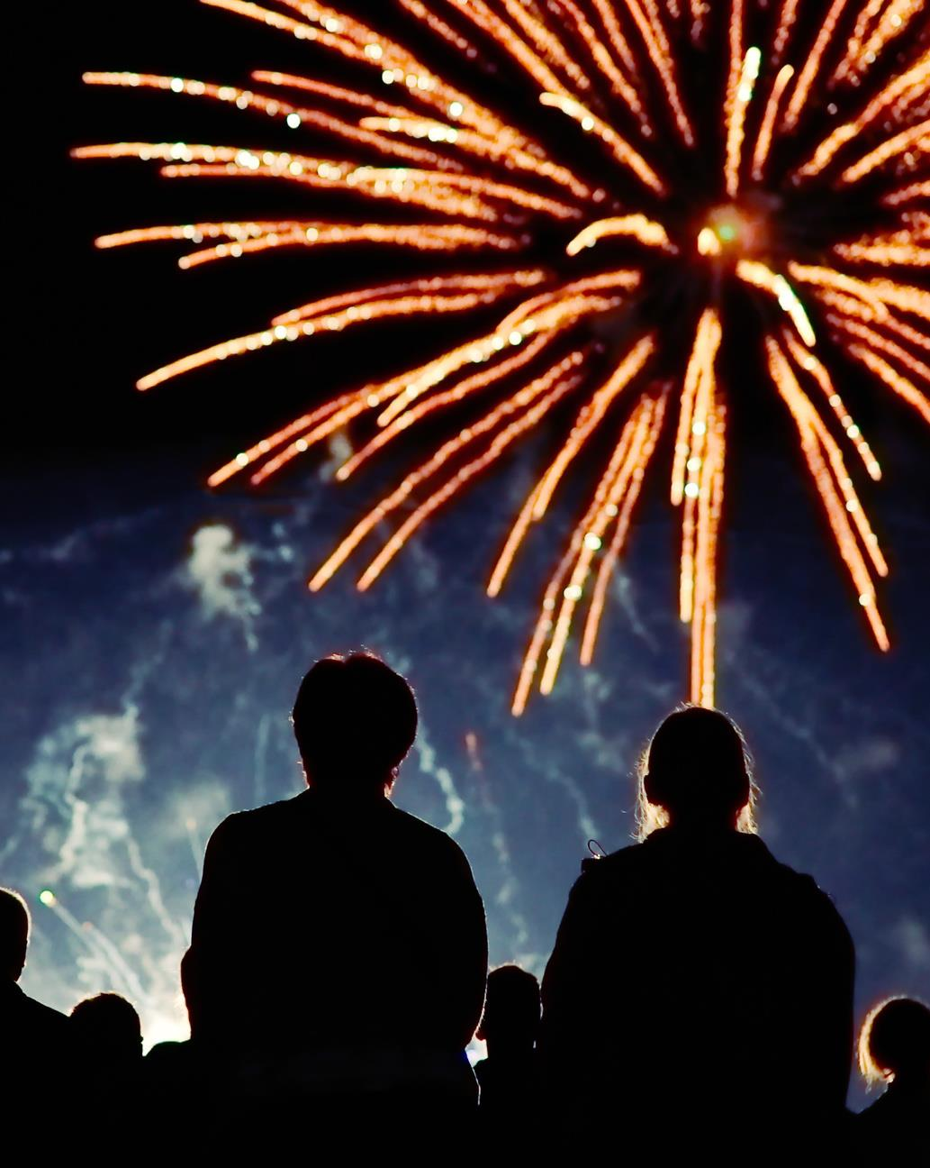



CODE
Read and follow the instructions on each firework using a torch if necessary
Light the firework at arm's length with a taper and stand well back ​
Keep naked flames, including cigarettes, away from fireworks ​
Never return to a firework once it has been lit ​
Only buy fireworks which carry the CE mark, keep them in a closed box and use them one at a time
REMEMBER ONLY ADULTS SHOULD BE LIGHTING FIREWORKS AND SETTING BONFIRES
Notes:
Go over this briefly and link back to what the young people have said. Do spend more time on points that were NOT raised​​
Emphasise that only adults should be lighting fireworks and it is important that you remind the adults of the firework code too.​
The CE mark means that the product is safe when handled correctly ​

Slide 6
FIREWORKS SAFETY
CODE CONTINUED​
Don't put fireworks in pockets and never throw them ​
Direct any rocket fireworks well away from spectators ​
Never use paraffin or petrol on a bonfire
Make sure that the fire is out and surroundings are made safe before leaving
Plan your firework display to make it safe and enjoyable, and ensure it finishes before 12am midnight
Notes:
Go over this briefly and link back to what the young people have said. Do spend more time on points that were NOT raised​
Emphasise that only adults should be lighting fireworks and it is important that you remind the adults of the firework code too.​

Slide 7


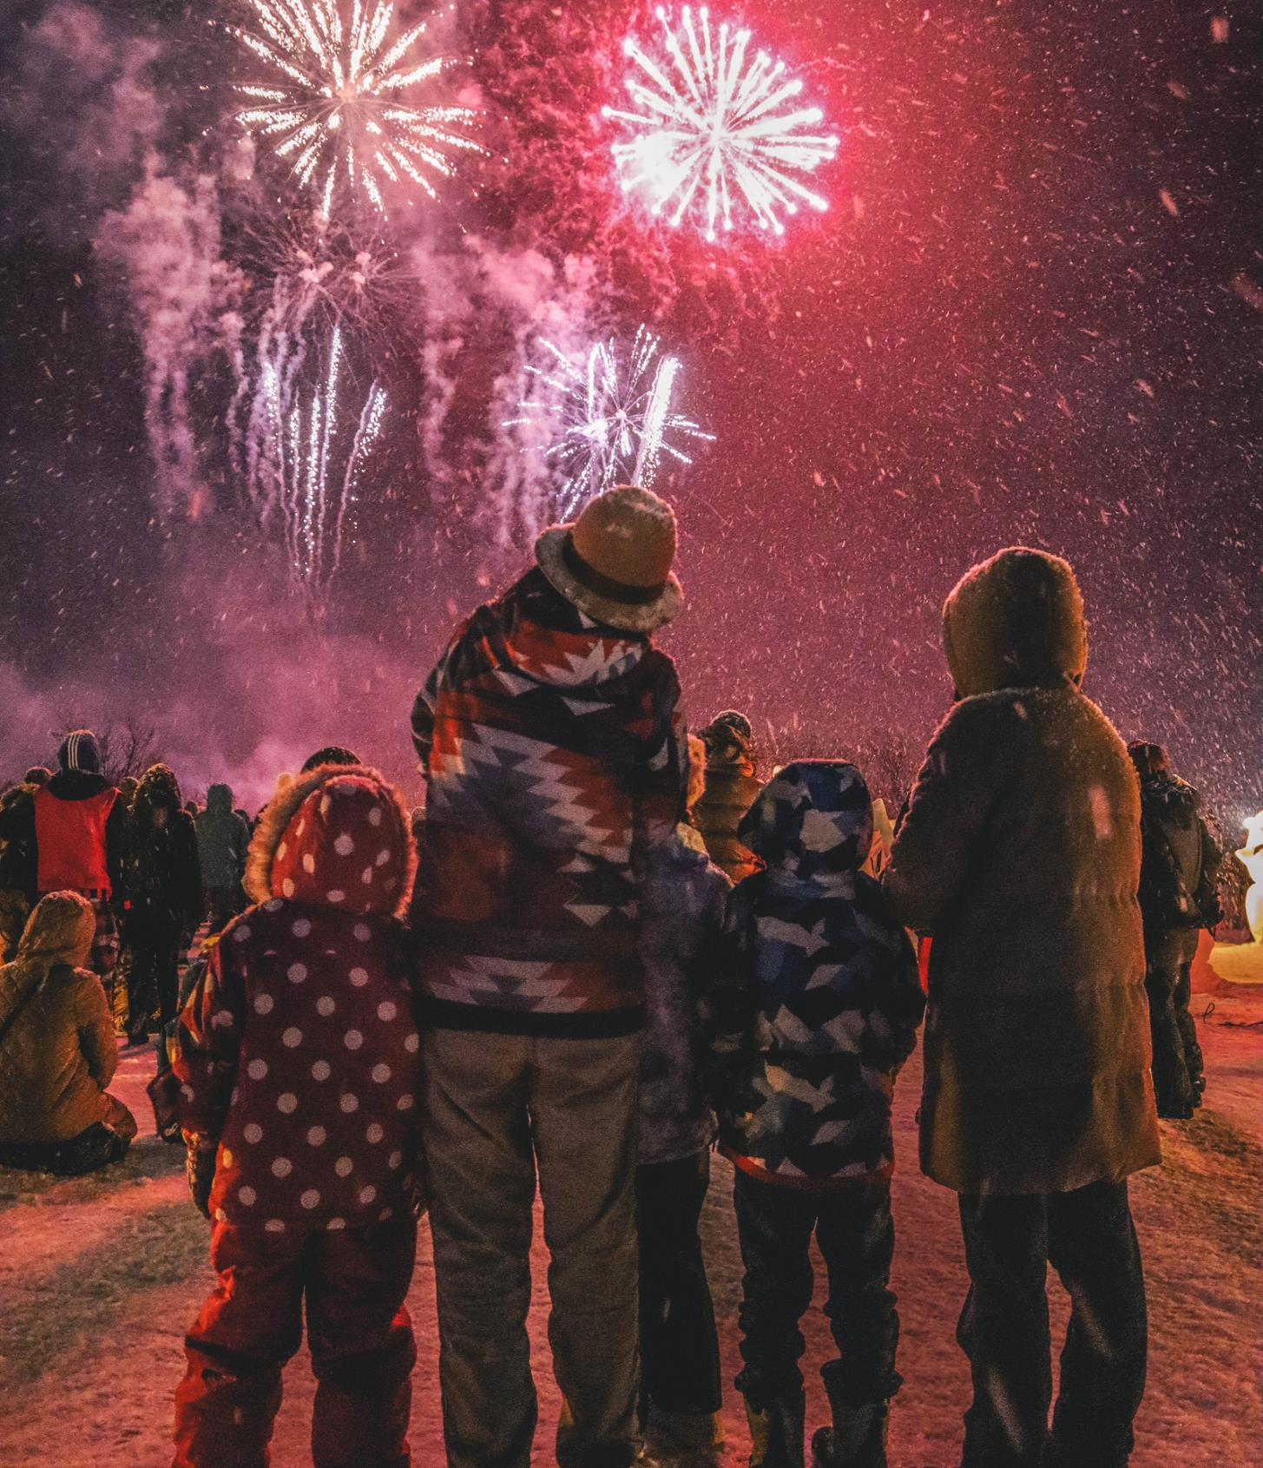
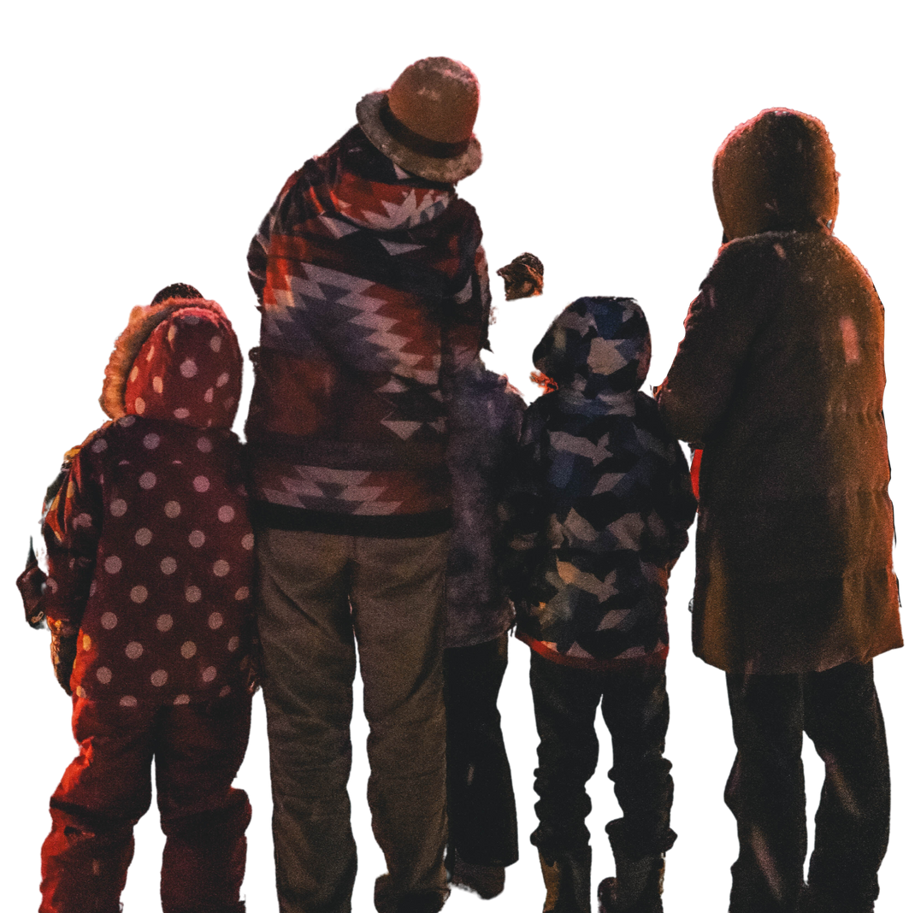
REMEMBER
ONLY ADULTS
SHOULD BE LIGHTING FIREWORKS AND SETTING BONFIRES.

Slide 8
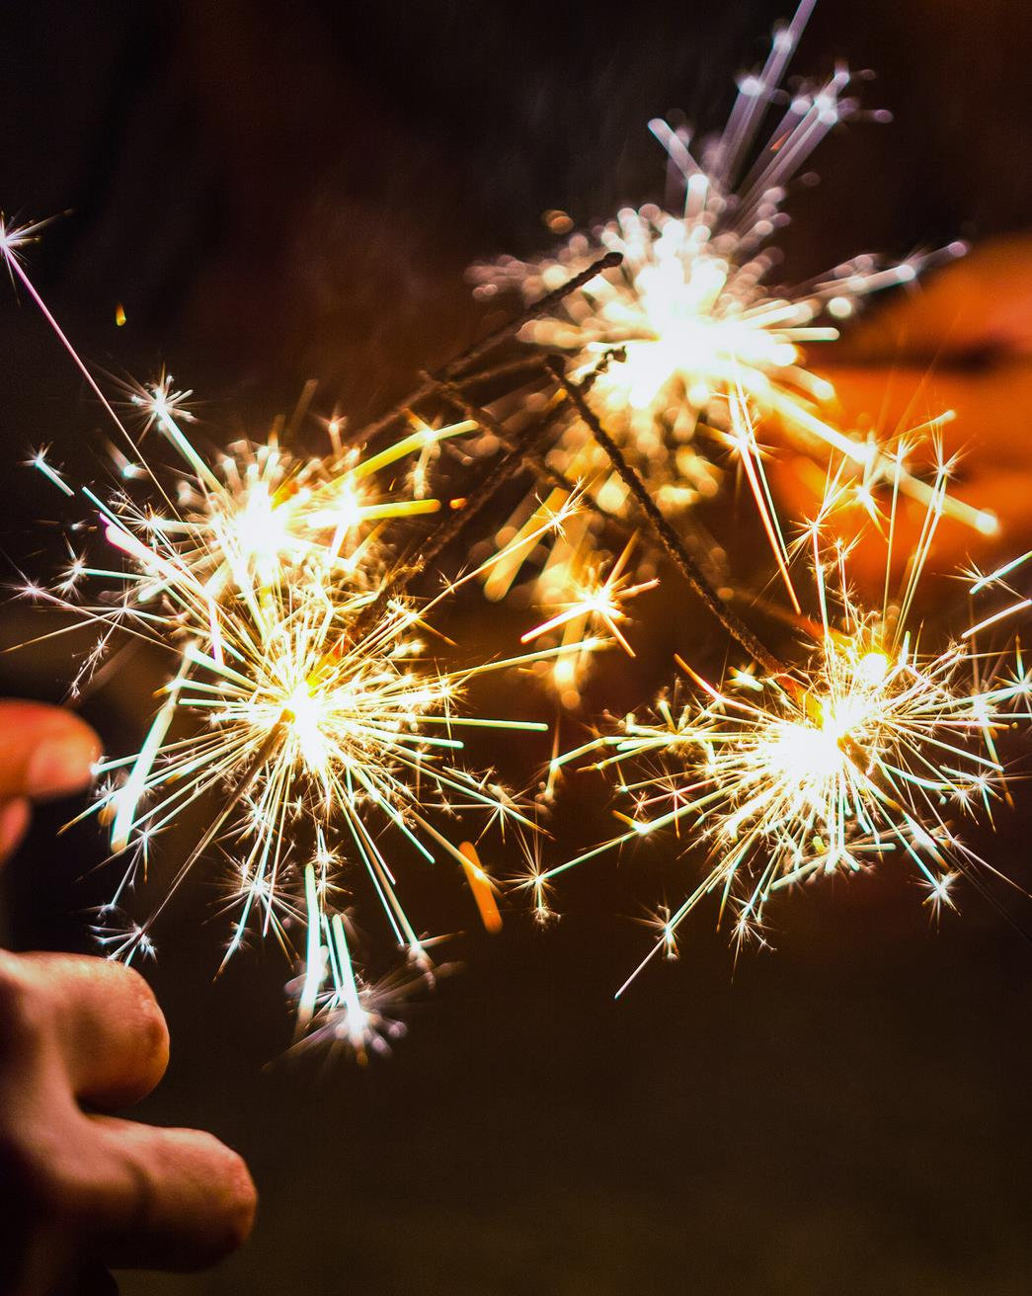
SPARKLER
QUIZ
What age should you be before you can hold or use a sparkler?
What should you wear when holding a sparkler?
How many sparklers should you use at one time?
Where should you put a sparkler once it’s finished?
KEEP YOURSELF AND OTHERS SAFE.
Notes:
Have the young people shout the answers – This activity is to find out what they already know and expand on existing knowledge.​
Question 1 – answer is 5.
Ask the young people why they think under 5s shouldn’t use a sparkler. Emphasis that a sparkler is a firework and even though they can be given to children they can burn up to 1500 C which is really hot (hotter than an oven on full blast) so young children can be easily burned. Young children often don’t have a full understanding of being safe ie young babies and toddlers putting things in their mouths link to safety warnings that they may see saying do not give to under 3s etc​
Question 2 – the answer is gloves.
Sparklers can become really hot as previously mentioned and gloves provide your hands with protection​
Question 3 – One sparkler at a time
Question 4 In a bucket of water / sand

Slide 9
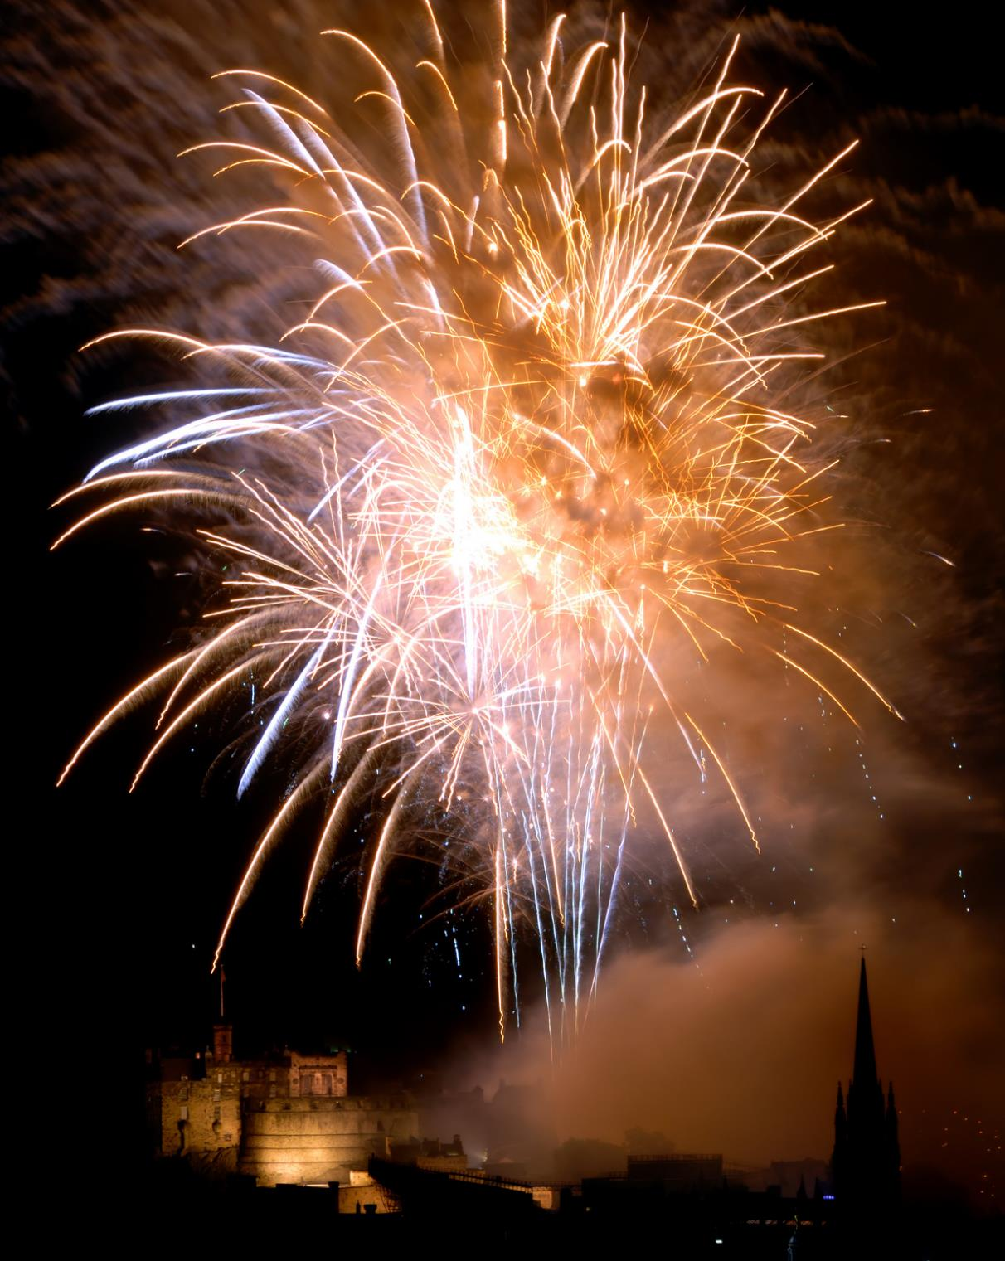
WHAT DO YOU DO IN AN EMERGENCY
IF SOMEONE HAS BEEN BURNED BY A FIREWORK?
Get help from an adult
Cool the burn or scald with cool or lukewarm running water for 20 minutes​
Cut around the material sticking to the skin – don’t pull it off​
Lay cling film over the burn​
Don’t touch the burn or burst any blisters​
If clothing catches fire then STOP, DROP and ROLL​
Seek medical advice from your doctor, minor injuries clinic or hospital​
Notes:
Cool the burn as quickly as you can after the burn and NEVER use ice, iced water or any creams or greasy substances like butter​
Keep the person warm by giving them a blanket or extra clothing but do not put it over the burn – if you are cooling a large area the person could risk getting hypothermia by having cool water exposed on them for the length of time​
Use cling film because it will not stick to the burn/scald.
Plasters, bandages, towel and clothing can all leave debris in the burn/scald which makes it more painful to remove.
If you can bring in plasters and bandages and show that the material can rub against the skin and can get caught in the skin​
All advice taken from the NHS website on burns and scalds ​

Slide 10





YOUR
SAFETY
If your clothes catch fire:
Stop where you are.
  STOP!
Drop to the ground.
Roll over and over and back and forth until the flames are out.
2. DROP!
GET HELP FROM AN ADULT RIGHT AWAY.
The most important thing to remember is to stay
away from fire.
Only use “stop, drop, and roll” if your clothes are on fire.
3. ROLL!

Slide 11
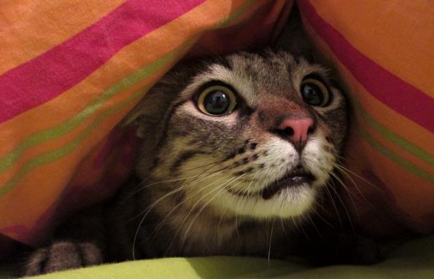
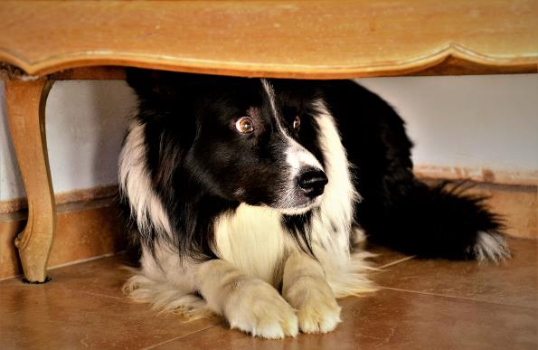
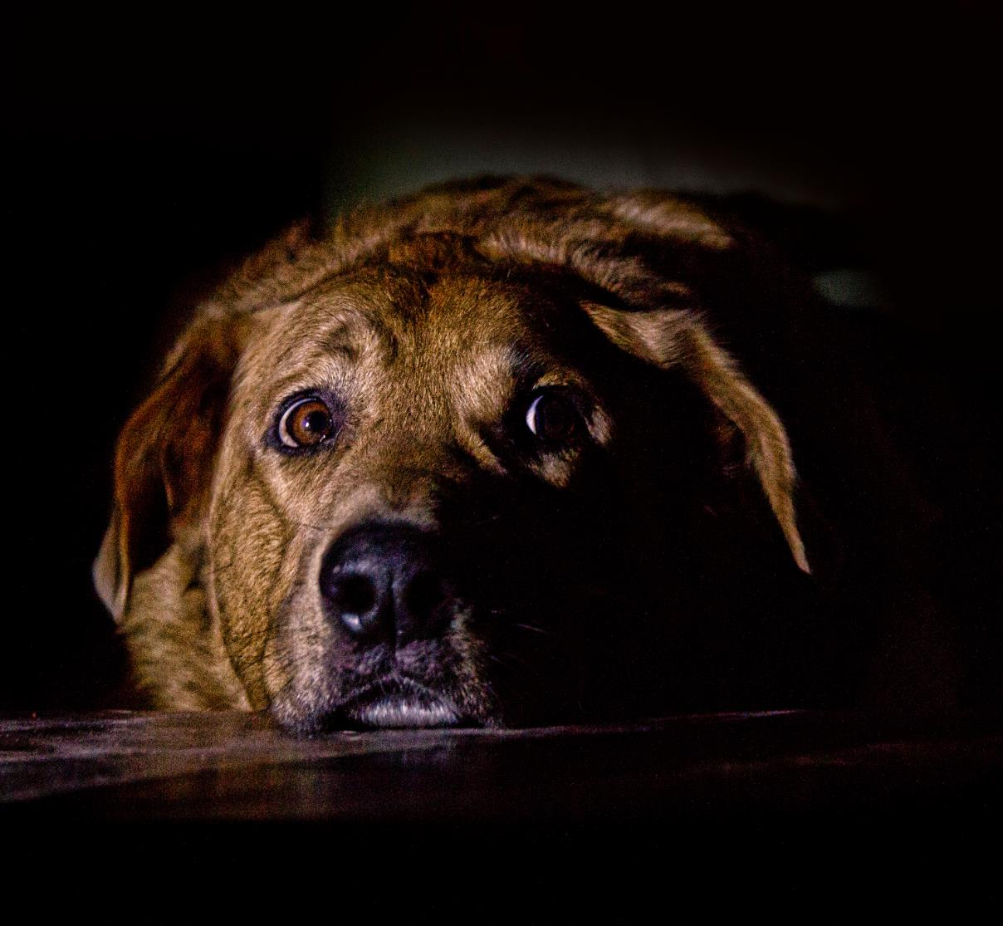
THINK OF
THE ANIMALS
Animals do not understand why
we have bonfires at night.​
​
They can become very upset and distressed by the loud noises, bright colours and smoke.​
Please listen to advice from the Scottish Society for the Prevention of Cruelty to Animals (SSPCA)
Notes:
Ask the young people what they could do to keep their pets calm and comfortable on bonfires night?​
Then play the video on the next slide from the SSPCA with their tips on how to keep pets comfortable on bonfires night.​

Slide 12

Notes:
Ask the young people what they could do to keep their pets calm and comfortable on bonfires night?​
Then play the video on the next slide from the RSPCA with their tips on how to keep pets comfortable on bonfires night.​

Slide 13
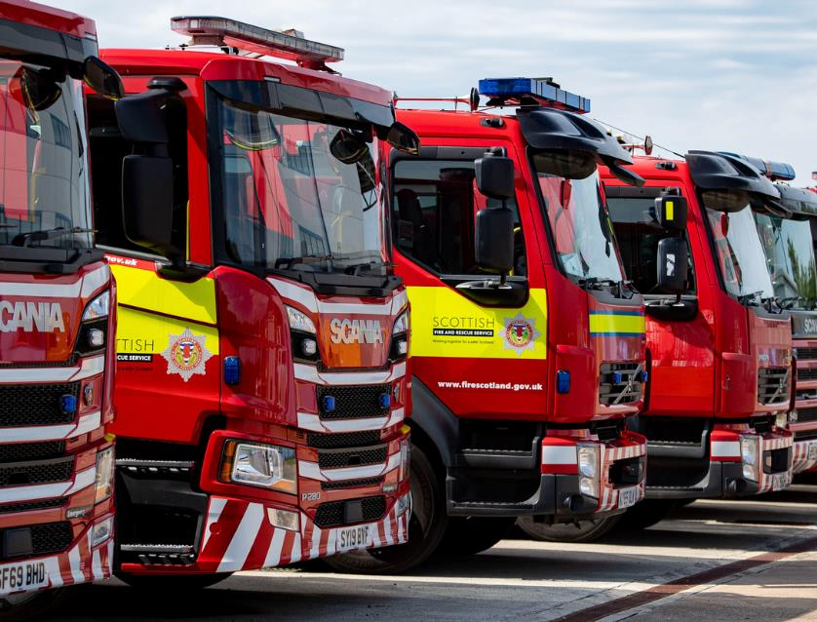
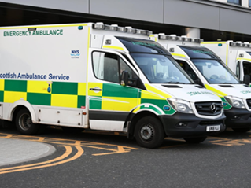
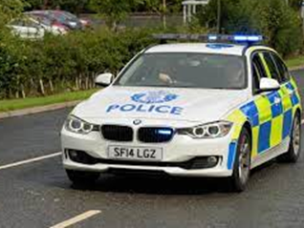
CALLING THE
EMERGENCY SERVICES​
CALL 999
Notes:
Remind the young people that the emergency services include the police, ambulance and fire service.
Ask the young people what the phone number is for the emergency services.
In the UK it is 999
Some may say 911 which is North America, however if they dial that number from a mobile phone in the UK it may be transferred to 999
Some might also answer 112 which is the European number and connects directly to 999.
It is free to phone the emergency services and you can call any time of the day or night as they are there to help.
An emergency is when
Someone’s life is at risk
Someone is injured
There is a fire
Immediate help is needed
Ask the young people if they phone 999 what information will they need to provide?
Remember it is important to speak clearly.
What emergency service you need
Where you are – give as much detail as possible such as postcodes.
Does everyone know their full address including postcode?
If you are not at home look at the buildings and landmarks around you.
What has happened – give as much detail as you can about what has happened.
They might ask if the person is breathing or conscious (awake)
If anyone is hurt – provide details of any injuries, sometimes the call handler will ask you to help the person.
The call handler will also want to know the name of the casualty and your name too.
Remember try and stay calm and answer all the call handlers questions, they know you will be scared and upset but they are getting help to you as soon as possible.

Slide 14
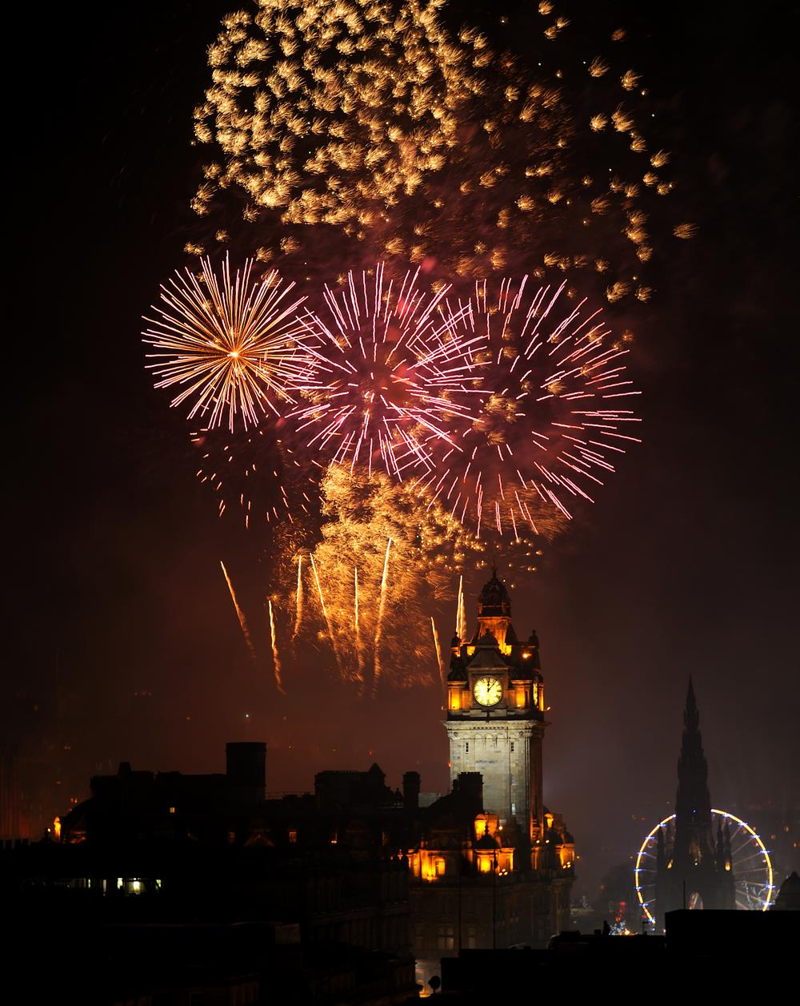


REMEMBER!!
  Be safe and responsible around fireworks​
  Follow the Fireworks Code​
  Call 999 if you need them

Slide 15

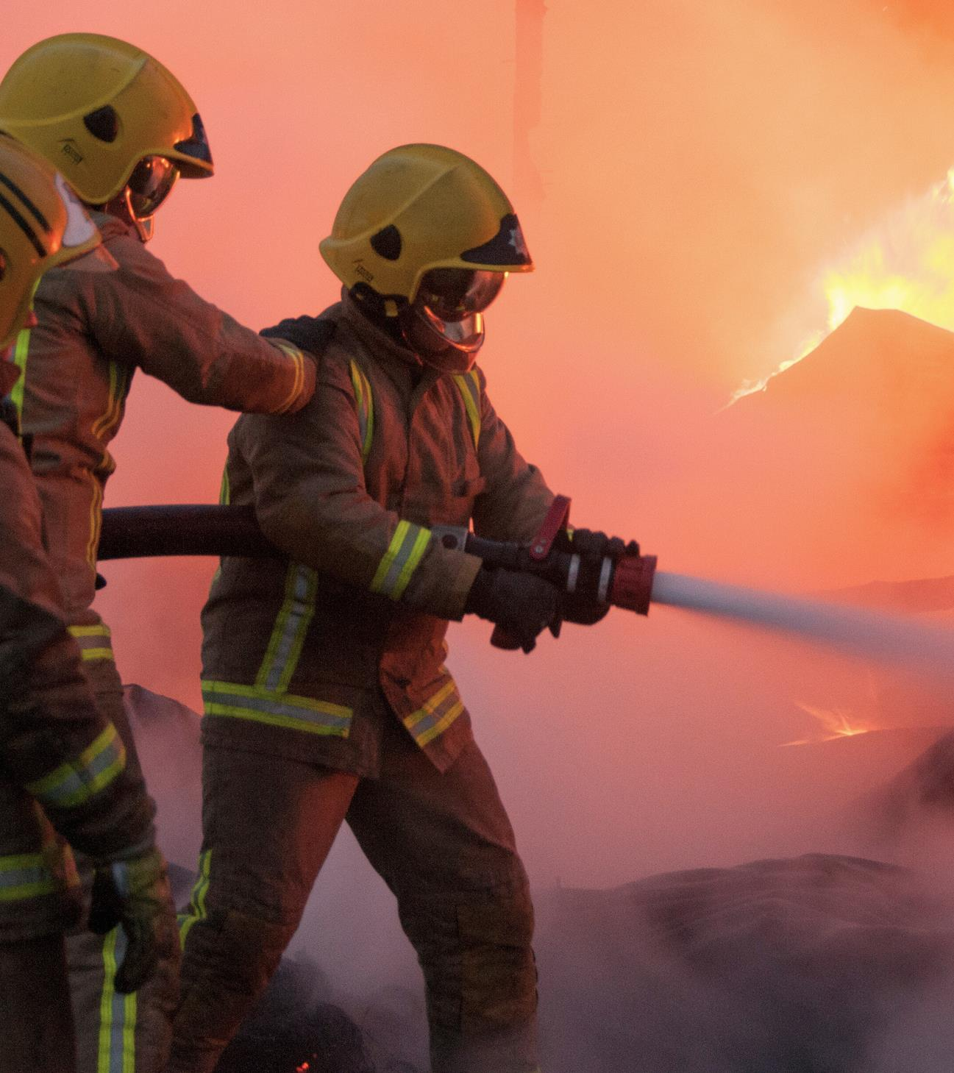


QUESTIONS

Slide 16


FIRESCOTLAND.GOV.UK
FIREWORK & BONFIRE SAFETY
PRIMARY SCHOOL LEVEL - PRESENTATION
Version 1.0 2023

